Slide 1

OPER 006: Fundamentals of Programming II Julia and Jupyter Lab
Capt Andrew Keith, Capt Phil Jenkins
25 Sep 2018
Disclaimer. The views expressed in this presentation are those of the authors and do not reflect the official policy or position of the United States Air Force, Department of Defense or the U.S. government.

Slide 2

Schedule Version 2.1.1
Mon (17 Sep) | Tues (18 Sep) | Wed (19 Sep) | Thurs (20 Sep) | Fri (21 Sep)
Analytical Tools Military Analysis | Code Development Version Control | Code Testing Code Maintenance Performance | R Python Jupyter Notebook
Mon (24 Sep) | Tues (25 Sep) | Wed (26 Sep) | Thurs (27 Sep) | Fri (28 Sep)
Matlab | Julia Jupyter Lab | Project | Project Wrap-Up
Fundamentals of Programming II
Keith & Jenkins, Air Force Institute of Technology

Slide 3
Agenda
Julia
Why Julia?
(Very) Brief History
Installation
Demos
Jupyter Lab
Installation
Demos
Fundamentals of Programming II
Keith & Jenkins, Air Force Institute of Technology

Slide 4
Julia History
1990
Python created
1994
Python 1.0
1995
R created
1997
R packages
2000
R 1.0 Python 2.0
2004
R 2.0
2006
NumPy 1.0
2008
Python 3.0
2012
Julia created
2013
R 3.0
2016
Rstudio 1.0, Tidyverse 1.0
2018
Julia 1.0
Fundamentals of Programming II
Keith & Jenkins, Air Force Institute of Technology

Slide 5
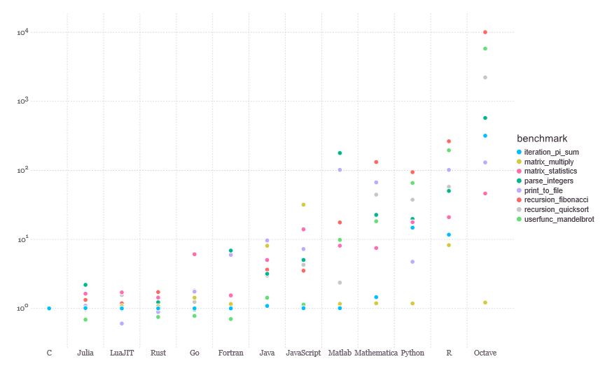
Why Julia?
Julia is fast!
https://julialang.org/benchmarks/
Fundamentals of Programming II
Keith & Jenkins, Air Force Institute of Technology

Slide 6
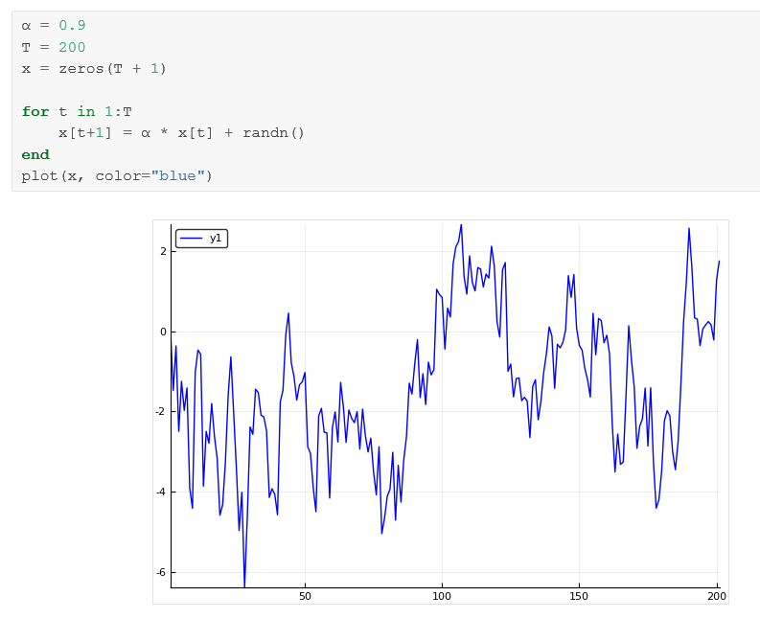
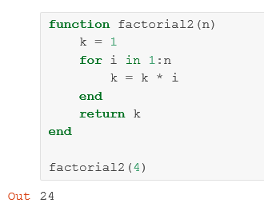
Why Julia?
Julia is easy to read and write!
https://lectures.quantecon.org/jl/julia_by_example.html#example-plotting-a-white-noise-process
Fundamentals of Programming II
Keith & Jenkins, Air Force Institute of Technology

Slide 7



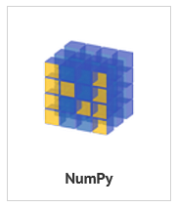
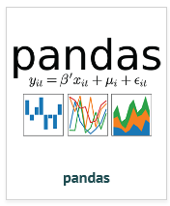




Why Julia?
Julia has committed support and funding!
Fundamentals of Programming II
Keith & Jenkins, Air Force Institute of Technology

Slide 8
WARNING
Your timing is almost perfect, but not quite.
Julia 1.0 released a few weeks ago. Most packages are expected to be usable in the next 1-2 months (although many packages are currently usable).
You can use Julia 0.6.4 now or you can wait a month or two and use Julia 1.0.
Fundamentals of Programming II
Keith & Jenkins, Air Force Institute of Technology

Slide 9
Why not Julia?
You need to add on to an existing project that uses a different language
You need a specific package in the next month (i.e. before some packages are ready on Julia 1.0)
You don’t care how fast the code runs
Fundamentals of Programming II
Keith & Jenkins, Air Force Institute of Technology

Slide 10
Installing Julia with Atom (easier)
Easy option: Download the free version of JuliaPro
Only includes Julia 0.6.4 and curated set of packages
Flexible option: Follow these steps
Pick Julia 0.6.4 or Julia 1.0, then pick your own packages after install
What is the difference between Atom and Juno?
Atom
Text editor than can be extended with open source packages
Juno
Set of extensions for Atom
Integrated development environment (IDE) for Julia
Fundamentals of Programming II
Keith & Jenkins, Air Force Institute of Technology

Slide 11
Installing Julia with Jupyter (harder)
First, make sure you’ve already installed Jupyter
(We did this in OPER 006-04)
Install your preferred version of Julia
Julia 1.0, Julia 0.6.4, or both!
Install the IJulia package (see next two slides)
Open a Jupyter notebook like normal
Fundamentals of Programming II
Keith & Jenkins, Air Force Institute of Technology

Slide 12
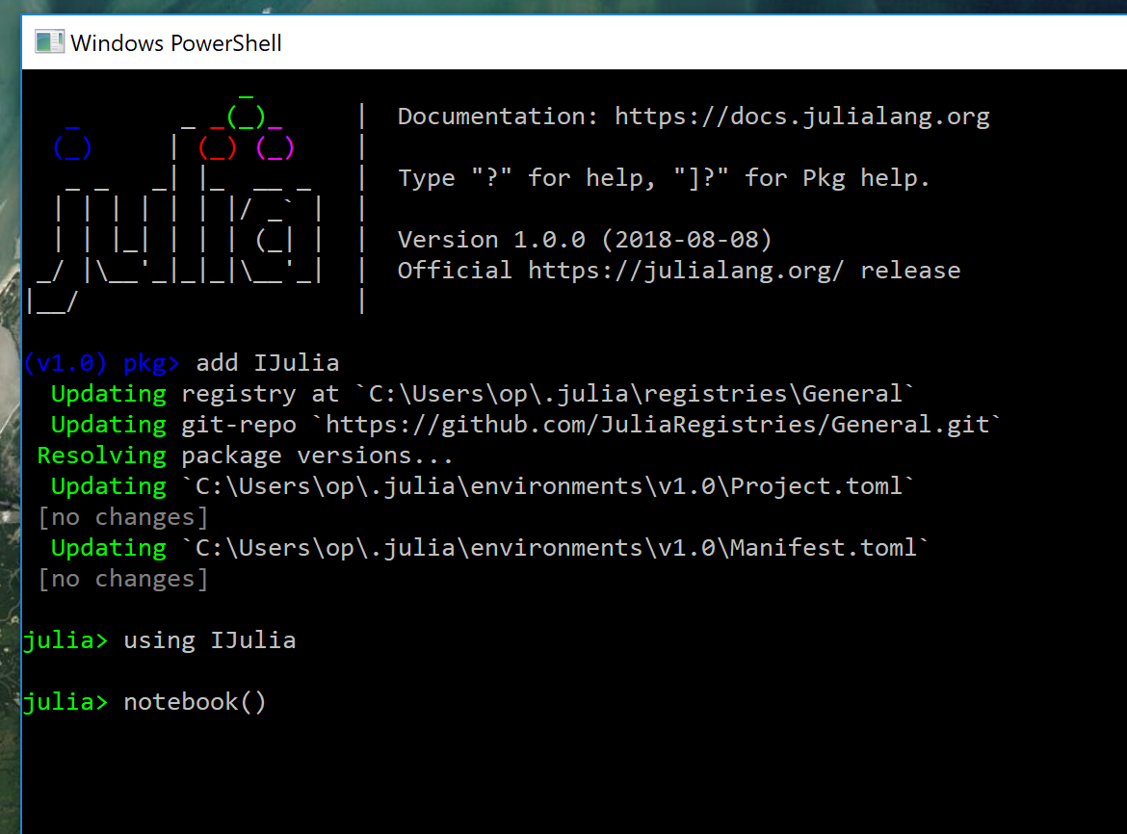
Installing Julia with Jupyter (harder)
Install the IJulia package on Julia 1.0
Open Julia (windows: search “Julia”, double-click on Julia 0.6.4)
Type “]” to enter package mode (blue prompt), enter the following command:
add IJulia
Return to the main Julia by pressing backspace (green prompt), enter following commands:
using IJulia
notebook()
This output will be longer when you run add IJulia for the first time
A Jupyter notebook should open in your browser after this
Fundamentals of Programming II
Keith & Jenkins, Air Force Institute of Technology

Slide 13
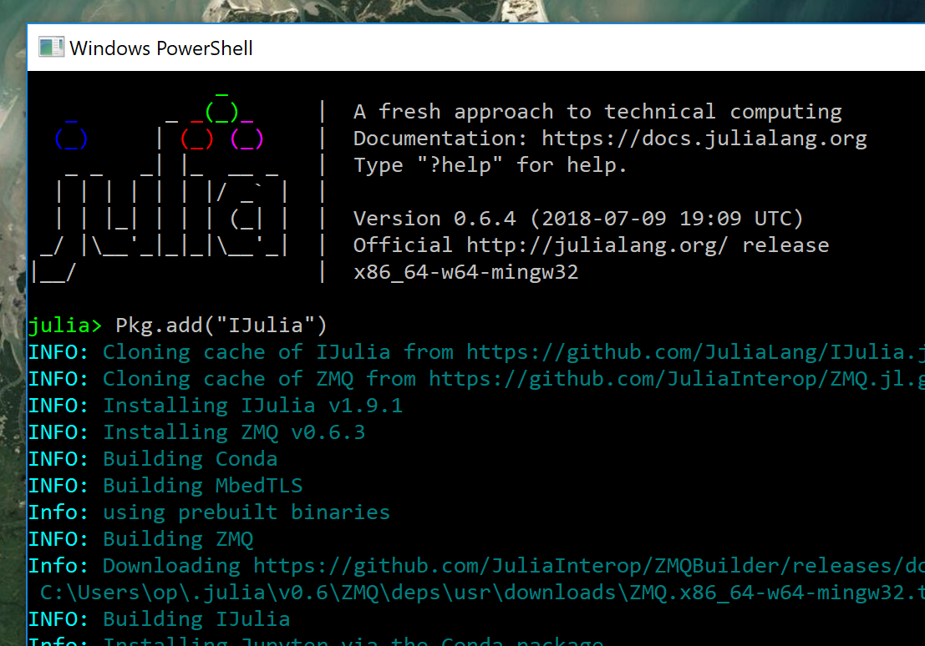
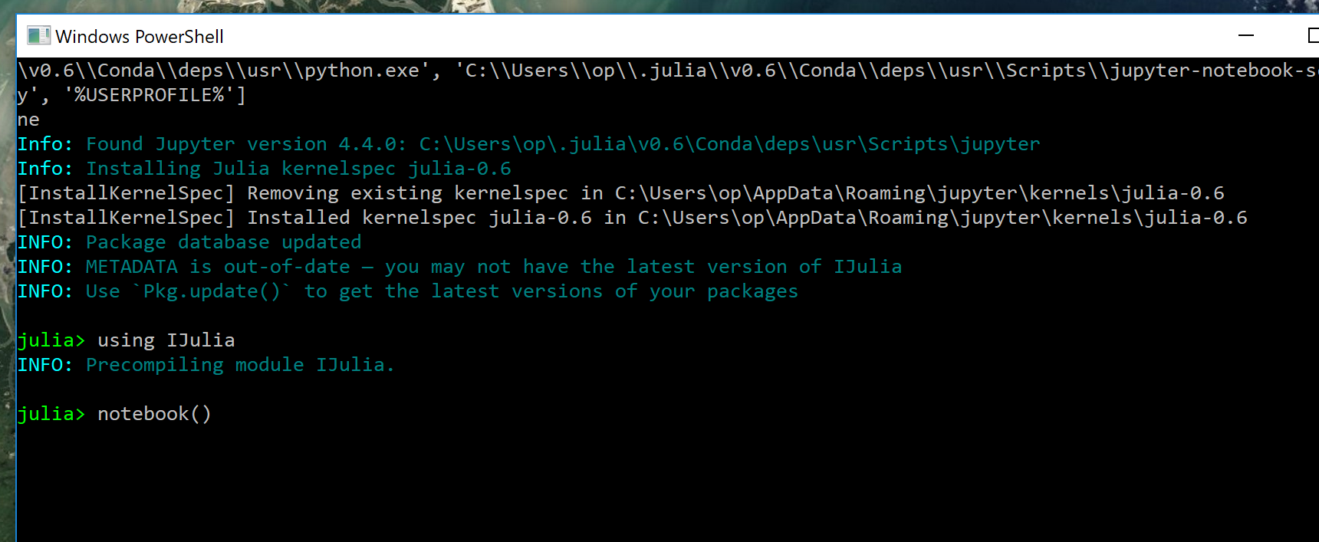
Installing Julia with Jupyter (harder)
Install the IJulia package on Julia 0.6.4
Open Julia (windows: search “Julia”, double-click on Julia 0.6.4)
Run the following commands (all in the main Julia mode (green prompt))
Pkg.add(“IJulia“)
using IJulia
notebook()
This output will go on for a while…
After the output from the first command finishes, enter these two lines
Fundamentals of Programming II
Keith & Jenkins, Air Force Institute of Technology

Slide 14
Installing Julia with Jupyter (harder)
First, make sure you’ve already installed Jupyter
(We did this in OPER 006-04)
Install your preferred version of Julia
Julia 1.0, Julia 0.6.4, or both!
Install the IJulia package (see next two slides)
Open a Jupyter notebook like normal
Fundamentals of Programming II
Keith & Jenkins, Air Force Institute of Technology

Slide 15
Julia Hands-On
I want to try Julia, but I don’t want to install it or deal with the different versions
Not even the easy install?
You can try Julia in your browser using JuliaBox (on wifi only)
Recommend trying: tutorials → introductory tutorials → intro-to-julia → 04. Loops
The “01. Getting started tutorial” is actually a little confusing in my opinion
I want to try Julia 0.6.4 using Jupyter or Atom
Follow this tutorial
If you’re using a Jupyter notebook, everything should look the same
If you’re using Atom with Juno, things will look different but everything should run the same
I want to try Julia 1.0 using Jupyter or Atom
No easy-to-follow tutorials right now…more coming in the next month or two
Deep introduction: ThinkJulia
Fundamentals of Programming II
Keith & Jenkins, Air Force Institute of Technology

Slide 16
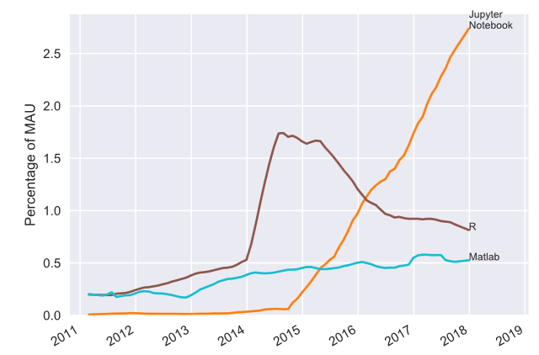
Jupyter
Jupyter is becoming extremely popular
Primarily Python users….for now
We already looked at Jupyter notebooks
Now let’s check out JupyterLab
Improved version of a notebook
In beta testing now, 1.0 expected this year
https://www.benfrederickson.com/ranking-programming-languages-by-github-users/
Fundamentals of Programming II
Keith & Jenkins, Air Force Institute of Technology

Slide 17
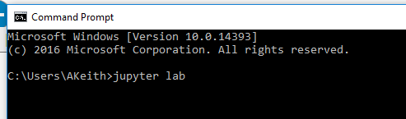
Installing JupyterLab (harder)
Follow the instructions here
Jupyter lab is in beta…we’ll need to use the command line to install and open it
Recommend using the “conda” method (uses Anaconda, which you may have already downloaded in OPER 006-04)
All the commands are in the Command Prompt (on windows: search “cmd”)
Start a JupyterLab session by typing “jupyter lab” in the command prompt
If this seems too complicated…you can always stick with jupyter notebooks (no command line needed)
Fundamentals of Programming II
Keith & Jenkins, Air Force Institute of Technology

Slide 18
JupyterLab Hands-On
Explore the demos here (wifi only)
Fundamentals of Programming II
Keith & Jenkins, Air Force Institute of Technology

Slide 19
Agenda
Julia
Why Julia?
(Very) Brief History
Installation
Demos
Jupyter Lab
Installation
Demos
Fundamentals of Programming II
Keith & Jenkins, Air Force Institute of Technology

Slide 20
Schedule Version 2.1.1
Mon (17 Sep) | Tues (18 Sep) | Wed (19 Sep) | Thurs (20 Sep) | Fri (21 Sep)
Analytical Tools Military Analysis | Code Development Version Control | Code Testing Code Maintenance Performance | R Python Jupyter Notebook
Mon (24 Sep) | Tues (25 Sep) | Wed (26 Sep) | Thurs (27 Sep) | Fri (28 Sep)
Matlab | Julia Jupyter Lab | Project | Project Wrap-Up
Fundamentals of Programming II
Keith & Jenkins, Air Force Institute of Technology

Slide 21
Combined History
1990
Python created
1994
Python 1.0
1995
R created
1997
R packages
2000
R 1.0 Python 2.0
2004
R 2.0
2006
NumPy 1.0
2008
Python 3.0
2012
Julia created
2013
R 3.0
2016
Rstudio 1.0, Tidyverse 1.0
2018
Julia 1.0
Fundamentals of Programming II
Keith & Jenkins, Air Force Institute of Technology

